Slide 1
Newton College & Career Academy
Advanced Academics Night
Advanced Placement & Dual Enrollment Information Session

Slide 2
Dual Enrollment vs. Advanced Placement (AP)
Students can potentially earn college and high school credit simultaneously.
Both save money compared to college tuition.
Both create the opportunity to graduate from college early.
Both add an additional 10 points to the final high school course grade.
Students can demonstrate success in college level courses.
Selective colleges expect to see transcripts with the high rigor that AP and DE provide.
Premature participation can backfire on students unprepared for the level of difficulty by damaging their GPA.

Slide 3
Dual Enrollment vs. Advanced Placement (AP)
Dual Enrollment:
Advanced Placement:
Classes are taken on the college campus.
Classes follow the college calendar (may conflict with the high school calendar).
Classes are geared toward an adult audience by teachers specifically trained for teaching adults.
Classes are treated as a transfer credit unless the student plans to graduate from the same college.
43% of transfer credits are not accepted by other schools (reported by Parchment.com).
Rigor varies by school.
College credit is based on the totality of the student’s work, not a single test score.
Classes, books, and fees are free for high school students.
Not all classes are available for dual credit.
Classes must meet specific high school requirements.
Grades become part of the college GPA.
Advanced Placement classes are college level classes taken at the high school.
Classes follow the high school calendar.
Classes are geared toward high school age students by teachers specifically trained for teaching adolescents.
AP credit is universally recognized because of the consistent standard of rigor.
AP classes require a test at the end of each class in order to earn college credit.
College credit is dependent upon a passing score on the final test.
AP classes provide a solid baseline for determining the student’s ability to handle college level work.
There is a fee for taking AP tests, currently $80.00 each. Financial assistance is available in many cases.
AP classes offer added “weight” to a high school GPA but do not affect their college GPA.

Slide 4
Advanced Placement Courses
AP courses are taught on the college level and may require 1-2 hours of homework each night, for each course taken.
All courses are year-long
NCCA Student Services recommends students have a grade of 85 or above in their current course to be eligible to take the next AP level course.
2 AP courses are required to be recognized in top 10 of graduating class
Access to CollegeBoard resources

Slide 5
Advanced Placement Test
Cost of test is determined by whether you get free or reduced lunch
(Make sure you complete the free/reduced lunch form at the beginning of the school year.)
STEM tests are free
Test preparation provided by teachers during the school year
Test Scores range from 1-5

Slide 6
Advanced Placement Courses at NCCA
Students will communicate interest in AP courses during NCCA Course Registration
AP Biology
AP Calculus AB
AP Calculus BC
AP Chemistry
AP Computer Science Principles
AP English Language/Comp.
AP English Literature/Comp.
AP Environmental Science
AP Macroeconomics
AP Physics
AP Pre-Calculus
AP Statistics
AP US History
AP World History
https://apstudents.collegeboard.org/

Slide 8
Dual Enrollment Participating Institutions
PUBLIC
Abraham Baldwin Agricultural College
Albany State University
Atlanta Metropolitan State College
Augusta University
Clayton State University
College of Coastal Georgia
Columbus State University
Dalton State College
East Georgia State College
Fort Valley State University
Georgia College & State University
Georgia Gwinnett College
Georgia Highlands College
Georgia Institute of Technology
Georgia Southern University
Georgia Southwestern State University
Georgia State University
Gordon State College
Kennesaw State University
Middle Georgia StateUniversity
Savannah State University
South Georgia State College
University of Georgia
University of North Georgia
University of West Georgia
Valdosta State University
TECHNICAL
Albany Technical College
Athens Technical College
Atlanta Technical College
Augusta TechnicalCollege
Central Georgia Technical College
Chattahoochee Technical College
Coastal Pines Technical College
Columbus Technical College
Georgia Northwestern Technical College
Georgia Piedmont Technical College
Gwinnett Technical College
Lanier Technical College
North Georgia Technical College
Oconee Fall Line Technical College
Ogeechee Technical College
Savannah Technical College
South Georgia Technical College
Southeastern Technical College
Southern Crescent Technical College
Southern Regional Technical College
West Georgia Technical College
Wiregrass Georgia Technical College
PRIVATE
Andrew College
Berry College
Brenau University
Brewton-Parker College
Clark Atlanta University
DeVry University
Embry-Riddle Aeronautical University
Emmanuel College
Georgia Military College
LaGrange College
Mercer University
Oglethorpe University
Paine College
Piedmont University
Point University
Reinhardt University
Saint Leo University
Shorter University
Thomas University
Toccoa Falls College
Truett McConnell University
Wesleyan College
Young Harris College

Slide 10
Dual Enrollment courses offered at NCCA
(Courses may be subject to change, pending student enrollment)
Automotive
Certified Nursing Assistant (Seniors have priority)
Cosmetology (must be 16 when the class starts or a Junior/Senior)
Law and Criminal Justice

Slide 11
22-23 GSU Dual Enrollment Presentation.pptx

Slide 12
Dual Enrollment
Admissions:
Admissions requirements may vary between colleges; see college website for details
Student is responsible for applying to the college of their choice
Student is also responsible for registering for tests
All NCCA students must be accepted to their college of choice by APRIL 21ˢᵗ, 2023.
College courses are offered on the semester system:
Students will take a set of courses in the Fall, while taking the same number of new courses in the Spring.
Course registration requires consultation and approval from School Counselor and must be initiated by student.
The Dual Enrollment Funding Cap is 30 semester or 45 quarter hours.

Slide 13
NCCA Dual Enrollment
Students should be independent and self-driven.
Recommend students have a grade of 85 or above in their current academic course
Some college courses have high school and/or college prerequisites
Juniors taking dual enrollment English will need to take 3 semesters of English and take the American Literature End of Course Test their senior year.
Students may select an approved college of choice for Dual Enrollment. Options include:
Georgia State University
Georgia Piedmont Technical College
Other approved Georgia institutions (go to gafutures.org)
Dual enrollment courses not offered at NCCA require independent transportation.

Slide 14
Dual Enrollment Websites
Dual Enrollment for the state of Georgia
https://www.gafutures.org/hope-state-aid-programs/scholarships-grants/dual-enrollment/
Dual Enrollment Funding Application:
https://www.gafutures.org/hope-state-aid-programs/scholarships-grants/dual-enrollment/application-procedure-and-deadline/
Dual Enrollment Course Directory:
https://www.gafutures.org/checs/dualenrollment/DECourseDirectory
Georgia Piedmont Technical College (GPTC):
https://www.gptc.edu/technical-education/high-school-students/
Georgia State University (GSU):
https://perimeter.gsu.edu/admissions/dual-enrollment/
Approved Dual Enrollment Colleges/Universities
https://www.gafutures.org/media/sa4b510v/dual-enrollment-eligible-institutions-fy-2023.pdf

Slide 15
QUESTIONS

Slide 16
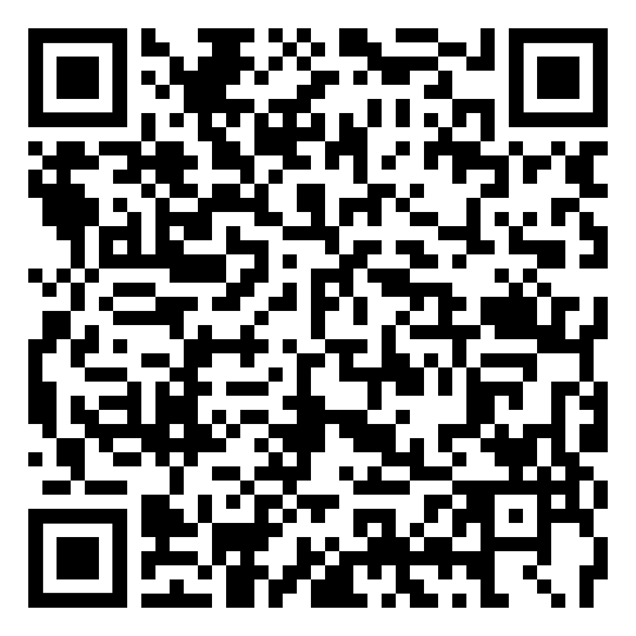
2023-24 Dual Enrollment Interest Form
Scan the QR Code to let us know you are interested in dual enrollment.

